Slide 1
Number Generator Integration
2346-01
13 November 2013
Notes:
Number Generator Plugins- <number>
Guidewire training materials contain Guidewire proprietary information that is subject to confidentiality and non-disclosure agreements. You agree to use the information in this manual solely for the purpose of training to implement Guidewire software solutions. You also agree not to disclose the information in this manual to third parties or copy this manual without prior written consent from Guidewire. Guidewire training may be given only by Guidewire employees or certified Guidewire partners under the appropriate agreement with Guidewire.

Slide 2
Lesson objectives
By the end of this lesson, you should be able to:
  Understand the role of number generation in each Guidewire application
  Implement the number generator plugins
  This lesson uses the notes section for additional explanation and information.
  To view the notes in PowerPoint, choose View→Normal or View→Notes Page.
  If you choose to print the notes for the lesson, be sure to select “Print hidden slides.”
Notes:
Number Generator Plugins- <number>

Slide 3
Lesson outline
Number generation in Guidewire
Number generator plugins
Implementing a number generator plugin
Application-specific issues
Notes:
Number Generator Plugins- <number>

Slide 4

Generated numbers
In addition to internal IDs and public IDs, some Guidewire entities need user-facing IDs that must:
  Be generated by the application
  Follow a pre-defined pattern
  Be user-friendly, unique, and possibly sequential
These IDs are casually referred to as generated numbers
  In practice, they are string values that may or may not be restricted to numeric characters
Notes:
Internal IDs are unique identifiers used by the application database to track each business object.
Public IDs are used to uniquely identify business objects across multiple systems. For a given object, the public ID may be generated by an external system and then used by Guidewire to identify the object as it is known in the external system. Or, the public ID may be generated by Guidewire and then exposed to external systems so they can identify a Guidewire business object in a way that makes sense to the external system.
Number Generator Plugins - <number>

Slide 5
Entities that make use of generated numbers
ClaimCenter
  Claim
    temporary number
    permanent number
PolicyCenter
  PolicyPeriod
  Job
BillingCenter
  Account
  CollateralRequirement
  Disbursement
  Invoice
  Statement
  Transaction
  TroubleTicket
Notes:
Most of the entities that have generated numbers need only one number. The one exception to this is Claim, which needs both a temporary and a permanent number. The temporary number is created at the beginning of the New Claim wizard, when the claim is committed to the database in "draft" status and is not yet considered ready for adjudication. The permanent number is created at the end of the New Claim Wizard, when the claim is committed to the database in "open" status and is considered ready for adjudication. The temporary number is useful for searching for claims that were only partially entered, whereas the permanent number is useful for searching for claims in the adjudication process. Temporary and permanent numbers tend to have different formats, so that an adjuster can easily identify that a claim is "draft" or "open".
Number Generator Plugin s- <number>

Slide 6
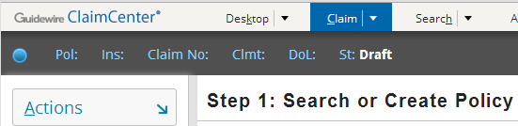
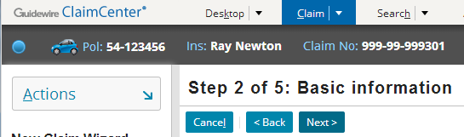
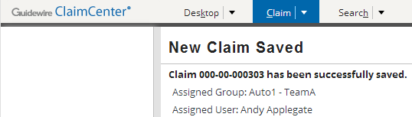
ClaimCenter: Claim numbers
At start of wizard, claim object not yet created (and therefore there is no claim number)
Once policy is identified, claim created with temporary number
When wizard successfully finished, claim is given permanent number
Notes:
A claim number is a unique identifier for a claim, and is often used by adjusters when searching for claims.
Claim numbers are typically generated by Guidewire code. However, it is possible that the claim is imported from another system (such as an FNOL system or from the legacy claim system). In these situations, if the claim already has a claim number, the existing number can be used in place of a generated number.
The screenshots above show a "Claim Number:" field in the New Claim wizard's info bar. This field is not present in the base application and has been added to the screenshots above only to identify the behavior of the claim number during the New Claim wizard.

Slide 7
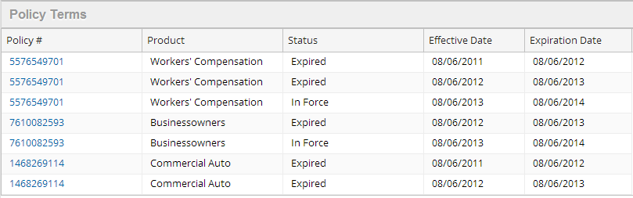
PolicyCenter: Policy numbers
Every policy has a policy number
  This is the policy number as understood by the policy holder
Policies have policy terms
  Have beginning and end dates
Notes:
Each transaction type has a different strategy for generating a policy number:
Submissions generate a completely new number.
Renewals may add or modify an incremental suffix.
Rewrites regenerate the number only if the underwriter requests a new policy number.
Other transactions (such as policy changes, cancellations, and reinstatements) simply reuse the previous policy period's number.
Number Generator Integration - <number>

Slide 8
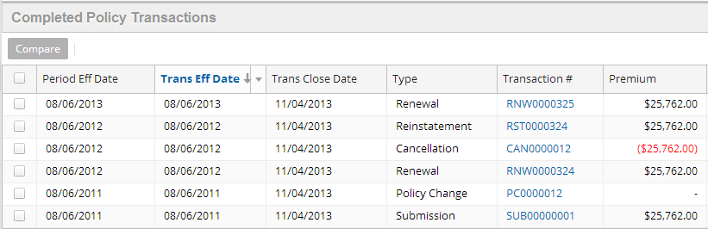
PolicyCenter: Transaction numbers
A transaction (or policy transaction) is a PolicyCenter object that coordinates the work of creating a new policy period and modifying the policy
Each transaction has a transaction number, which is simply a unique identifier
Notes:
Jobs are referenced in the PolicyCenter user interface as "policy transactions". Job numbers are referenced in the PolicyCenter user interface as "work order numbers".
Number Generator Integration - <number>

Slide 9

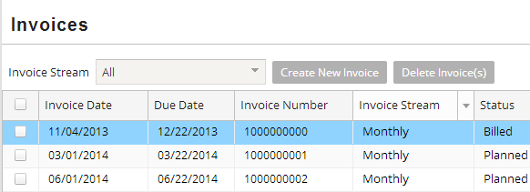
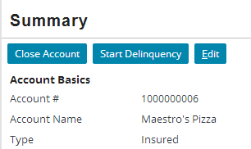
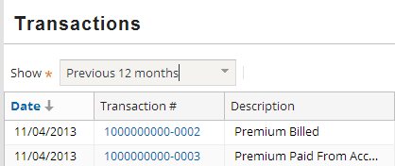
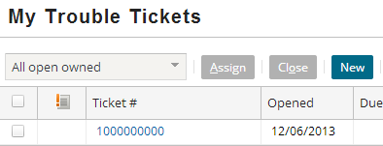
BillingCenter: Generated numbers
account
invoice
transaction
trouble ticket
collateral, disbursement, and statement (not shown)
Notes:
BillingCenter has seven types of entities that have user-friendly auto-generated numbers:
An account is a person or organization that is the owner of one or more policies and/or the payer of charges.
A collateral (not shown above) is an additional asset or amount that may be required of an account to secure coverage for a new or renewed policy.
A disbursement (not shown above) is a refund paid to an account, a producer, or a third party, usually because of a significant overpayment or policy change.
An invoice is a request for money sent to an account. It is created by BillingCenter for direct billing.
A statement (not shown above) shows commissions payable and payment activity for a producer. It is used for agency billing (as opposed to direct billing).
A transaction is a financial event in which money moves from one T-account to another, such as receiving payments, allocating money received to policies, or disbursing (refunding) money.
A trouble ticket identifies that an issue or exception exists on an account, policy, or producer that requires user attention and possibly intervention.
The screenshots above show four locations in the user interface where auto-generated numbers can be seen. This includes:
Account numbers on the Account tab's Summary screen.
Invoice numbers on the Account tab's Invoices screen.
Transaction numbers on the Policy tab's Transactions screen.
Trouble ticket numbers on the Desktop tab's My Trouble Tickets screen.
Number Generator Integration - <number>

Slide 10
Lesson outline
Number generation in Guidewire
Number generator plugins
Implementing a number generator plugin
Application-specific issues
Notes:
Number Generator Plugins- <number>

Slide 11
Number generator plugins
CC IClaimNumGenAdapter
PC IPolicyNumberGenPlugin
PC IJobNumberGenPlugin
BC INumberGenerator
A number generator plugin is a predefined plugin that creates generated numbers
  Numbers are generated in a format or pattern defined by the customer
  Each plugin can be implemented in Gosu or Java
  Data from object needing the number can be passed to the plugin, which can use the data to determine how to generate each number
Notes:
ClaimCenter has one plugin: IClaimNumGenAdapter, which generates claim numbers.
PolicyCenter has two plugins: IPolicyNumberGenPlugin, which generates policy numbers, and IJobNumberGenPlugin, which generates job numbers.
BillingCenter has one plugin: INumberGenerator, which generates numbers for all the entities that need generated numbers.
Number Generator Plugins - <number>

Slide 12
The sequence utility
next( )
2345046
2345046
number generator
plugin
The sequence utility is a Guidewire class used to generate unique numbers within unique sequences
  It is often used for number generation
The Guidewire database stores sequence information
  Maintains record of last number provided
The next() method used to request numbers
  Database provides next number in sequence
Notes:
The sequence utility is introduced in the "Gosu for Integration" lesson. These slides simply review the utility.
Number Generator Integration - <number>

Slide 13
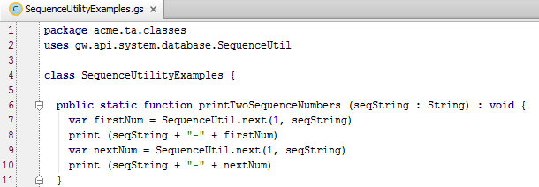
Using the sequence utility
Syntax: gw.api.system.database.
SequenceUtil.next(minVal, seqKey)
Notes:
The SequenceUtilityExamples class shown above can be found in TrainingApp in both the trainingapp.demo.gosu and the acme.ta.classes packages.
Syntax notes:
seqKey is the Sequence key. It is a string of up to 26 characters that uniquely identifies the sequence.
minVal is the minimum value, of type Long, for the sequence. It specifies the value to use if this is the first request for a number in the specified sequence. On all requests beyond the first one, this value is ignored.
The return value is the next number in sequence and is of datatype long.
When a sequence is started, it will issue its first value as minValue. After that, the returned value is just the most recently returned value plus one. The next(..) function is designed to be consistent across different database products.
On and before the Bedrock platform (ClaimCenter 5.0, PolicyCenter 3.0, and BillingCenter 2.x), next was a non-blocking method. If it fails to get a value after a set number of tries, then it throws an unchecked exception. The number of tries is configurable. As of the Carbon platform (ClaimCenter 6.0, PolicyCenter 4.0, and BillingCenter 3.0), next is a blocking method. The Carbon implementation gets an UPDATE lock on the row up front. This does cause blocking until the lock is acquired, but it results in much faster performance in a multiuser environment and eliminates the problem of surrenders in the Bedrock code due that occurred when the specified number of retries was exceeded.
(continued)
Number Generator Integration - <number>

Slide 14
(Notes only slide)
Notes:
Note that if a request for the next sequence value blocks for a long period, due to waiting for the update lock, there may be an exception thrown from elsewhere, such as from the database Connection object. JDBC connection implementations typically throw an exception if no reply is received through the connection after a certain timeout period. Therefore implementations using the SequenceUtil should be prepared for an exception throw from calls to next(). The next() implementation itself will not directly throw a new exception.
The Java API for plugins exposes a similar sequence utility in com.guidewire.pl.plugin.util package.
The Java and Gosu APIs for plugins expose an entity called Sequence that represents the sequences in the xx_sequence table.
Number Generator Integration - <number>

Slide 15
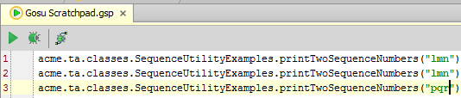
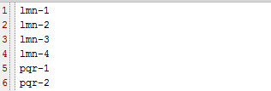
SequenceUtil in action
First call (using "abc")
First call (using "lmn")
Second call (using "lmn" again)
Second call (using "abc" again)
First call (using "pqr")
Third call (using "xyz")
Notes:
The screenshots above show a simple example of using SequenceUtil.
The first line of the Gosu Tester code is a call to the printTwoSequenceNumbers method for a sequence whose key is "abc". In the printTwoSequenceNumbers function, there are two calls to next. Line 9 is the first call. Because there have been no previous calls for the "abc" sequence, the minimum value, which is specified in the next method as 1, is returned. Line 10 simply prints the sequence key followed by a hyphen and the number returned. On line 11, a second call is made to next. Because this is not the first call for the "abc" sequence, the minimum value is ignored and the method returns the next number in the sequence. (In this case, it is 2.)
The second line of the Gosu Tester code is a second call to the printTwoSequenceNumbers method for sequence "abc". In the printTwoSequenceNumbers function, lines 9 and 11 call the next method. Neither of these calls are the first call for sequence "abc", so the next numbers in the sequence (3 and then 4) are returned.)
The third line of the Gosu Tester code is a third call to the printTwoSequenceNumbers method. This time, sequence "xyz" is specified. Because this is a new sequence, the first call to next uses the minimum value of 1.
Number Generator Integration - <number>

Slide 16
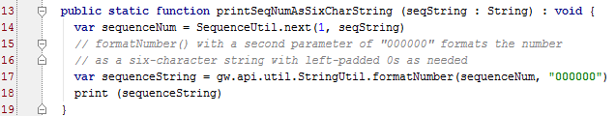
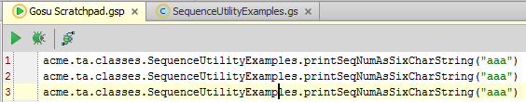

SequenceUtil and number generation
The plugin code typically needs to format the results of next() to ensure the final value is of the correct length
Notes:
next() returns a long value with a varying number of digits, but number generators typically return a string with a fixed set of characters. Therefore, the plugin code should format to the correct number of digits if necessary. This is usually most easily done using the StringUtil's formatNumber() method. Complete documentation of this method is available from Studio's Gosu API Reference (From Studio, select Help -> Gosu API Reference to display it.)
Number Generator Integration - <number>

Slide 17
Lesson outline
Number generation in Guidewire
Number generator plugins
Implementing a number generator plugin
Application-specific issues
Notes:
Number Generator Plugins- <number>

Slide 18
Steps to implement plugins
Determine plugin requirements
Write plugin class
Configure the plugin registry entry
Deploy the changes
Notes:
Note: if you are writing Java plugins, there are two additional steps between steps 2 and 3:
Compile plugin class
Move the class file to the appropriate Guidewire directory
Number Generator Integration - <number>

Slide 19
Step 1: Determine requirements (interface)
Number plugins must implement the appropriate interface:
  ClaimCenter
    IClaimNumGenAdapter
  PolicyCenter
    IPolicyNumGenPlugin
    IJobNumberGenPlugin
  BillingCenter
    INumberGenerator interface
Notes:
Packages for claim number interfaces:
Gosu: gw.plugin.numbergenerator.INumberGenerator
Java: com.guidewire. bc.plugin.numbergenerator.INumberGenerator
Packages for policy number interfaces:
Gosu: gw.plugin.policynumgen.IPolicyNumGenPlugin
Java: com.guidewire.pc.plugin.policynumgen.IPolicyNumGenPlugin
Packages for job number interfaces:
Gosu: gw.plugin.jobnumbergen.IJobNumberGenPlugin
Java: com.guidewire.pc.plugin.jobnumbergen.IJobNumberGenPlugin
Packages for claim number interfaces:
Gosu: gw.plugin.numbergenerator.INumberGenerator
Java: com.guidewire. bc.plugin.numbergenerator.INumberGenerator
Number Generator Integration - <number>

Slide 20
Step 1: Determine requirements (methods)
Claim number:
  generateTempClaimNumber()
  generateNewClaimNumber()
Policy numbers:
  genNewPeriodPolicyNumber()
  genNewJobNumber()
BillingCenter numbers:
  generateAccountNumber()
  ...
  generateTroubleTicketNumber()
Each method:
  Has one input parameter (the object needing the number)
  Returns a string to be used as the object's number
Notes:
The claim number interface, IClaimNumGenAdapter, has a third method: cancelNewClaimNumber(). This method provides for rare case where a claim number is generated but not needed, and the number needs to be recycled to avoid sequence gaps.
The full list of BillingCenter methods are:
generateAccountNumber()
generateCollateralRequirementNumber()
generateDisbursementNumber()
generateInvoiceNumber()
generateStatementNumber()
generateTransactionNumber()
generateTroubleTicketNumber()
The string returned by the various generate...Number() methods must not be null, and must not conflict with any field-level validator.
Number Generator Integration - <number>

Slide 21
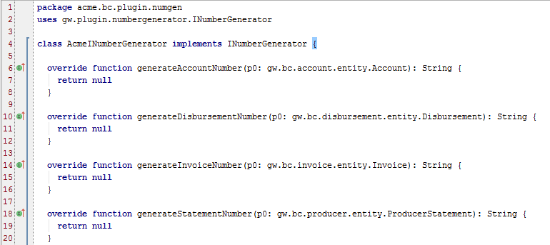
Step 2: Write the plugin class
(BC example)
Notes:
Guidewire recommends:
Storing Gosu plugins in a package named: <company>.<app_code>.plugin.<functional_area>.
Storing Java plugins in a package named: com.<company>.<app_code>.plugin.<functional_area>.
The plugin class should be named: <meaningfulName><interfaceImplemented>
Packages
To create a new package, right-click the parent and select New -> Package. Then, provide a name for the package.
When you are using Studio to create your new class, create it within a root package that you created (such as the acme package above). Do not create your own plugins within the built-in gw.* package hierarchy or the plugins.* package hierarchy in Studio. These packages have special functionality reserved for the Guidewire application.
Classes
To create a new class, right-click the parent package and select New -> Class. Then, provide a name for the class. Studio automatically creates a shell class for you, including a construct method. Most plugins do not require the construct method, though, so in most cases you can delete it.
The code for Gosu classes is automatically stored in modules\configuration\gsrc.
Number Generator Integration - <number>

Slide 22
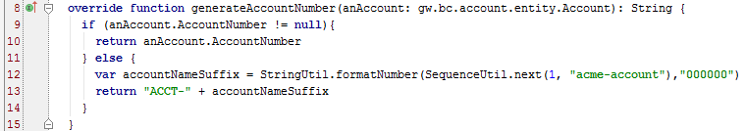
Sample number generator method
(BC example)
For the account number above:
  The first part is the literal string "ACCT-"
  The second part is a formatted value derived from the sequence utility
Notes:
In the example above, account numbers take the format: ACCT-NNNNNN, where:
ACCT- is a literal string
NNNNNN is a six-character string representing a sequential number starting at 1.
A soft copy of the INumberGenerator class shown in the examples can be found at the end of this lesson.
Number Generator Integration - <number>

Slide 23
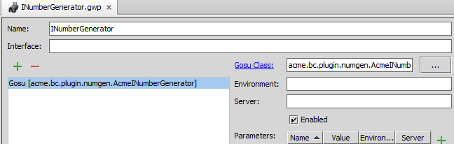


Step 3: Configure the plugin registry entry
Notes:
To modify the claim number generator plugin registry entry:
Select the registry entry.
Replace demo class with custom class.
Click Save.
Number Generator Integration - <number>

Slide 24
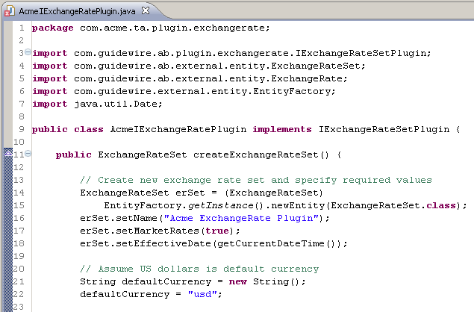
Step 4: Deploy plugin metadata
Registry entries, Java classes, and field validators are read during server start-up
  Changes to these resources require a server restart
If you change only Gosu code, all that is required is a metadata reload (ALT+SHIFT+L)
restart
reload
Notes:
Be aware that, in dev mode, if you connect Studio to the application (or disconnect and then reconnect Studio), the connection process executes an implicit metadata reload.
Number Generator Integration - <number>

Slide 25
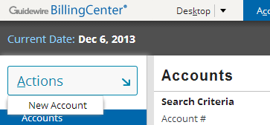
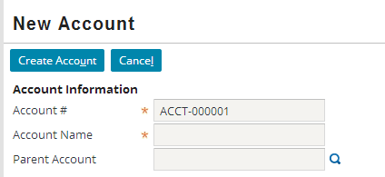
Example: Completed plugin implementation
Notes:
The account number shown above has been generated from the AcmeINumberGenerator implementation of the plugin. A soft copy of the AcmeINumberGenerator class shown in the examples can be found at the end of this lesson.
Number Generator Integration - <number>

Slide 26
Lesson outline
Number generation in Guidewire
Number generator plugins
Implementing a number generator plugin
Application-specific issues
Notes:
Number Generator Plugins- <number>

Slide 27
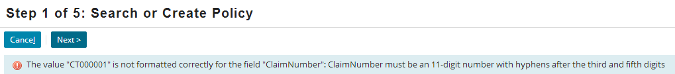
ClaimCenter: Claim field validator
ClaimCenter implementations typically have a field validator for the claim number field
  Any value imported or generated for claim numbers must match this validator
  If the value does not match the validator, the claim cannot be committed to the database
Notes:
Number Generator Plugins- <number>

Slide 28

ClaimCenter: Modifying claim number field validator
Field validators declared in fieldvalidators.xml
  description - display key used for validation error message
  name - validator name
  value - pattern field must follow, as specified with this syntax:
    [charRange]{X} - X characters in charRange, which can be any combination of 0-9, a-z, and A-Z
    [charRange]{X, Y} - From X to Y characters in charRange
    ( )? - Zero or one instances of the characters in the ( )
    Most other characters (such as -) are treated as literals
Notes:
The pattern for the claim number field as shown above translates in English to:
Either the letters "CP", followed by a hyphen, followed by four digits or three digits, followed by a hyphen, followed by two digits, followed by a hyphen, followed by six digits, or both.
The input mask identifies a mask used whenever the field is displayed in the user interface. The syntax for input masks is:
# - Any character the user can type
Rendered in UI as a "."
All other characters (such as -) are treated as literals
To specify no input mask, use "". If a mask has fixed characters on the end, the application displays those characters outside of the text field. For example ####mph appears as a field #### with mph on the outside end of it.
In some cases it may not be possible to apply a mask in a validator, although we can still enforce that a field value matches a given regular expression. For example, suppose that for all auto claims, the number should be of the form "AUTO-CC-1234567" , but all Worker's comp claims should be given numbers of the form "WRK-CC-12345" . In this case, there is no single mask that would work well for both kinds of numbers. The best approach would probably be to just omit the input mask.
For a complete listing of syntax for the value and input mask attributes, consult the Configuration Guide for your product.

Slide 29
BillingCenter: Transaction numbers
Of the seven BC entities that have generated numbers, the one that is instantiated the most often is Transaction
  Most actions involve money moving from one T-account to another, which is captured in a transaction
Code that generates Transaction numbers should be optimized for high throughput
Notes:
For the duration of a single policy with a six-month term, an account may have 6 invoices (if it makes use of direct bill) or 6 statements (if it makes use of agency bill). It will typically have from zero to a small number of collatorals, disbursements, and/or trouble tickets. However, each invoice (or statement) and each payment that results from each invoice (or statement) typically involves multiple transactions. Therefore, among auto-generated number entities, Transaction instances can be created at a rate that is from 10 to 1000 times greater than any other entity instances.
Number Generator Integration - <number>

Slide 30
Transaction number generation in the base application
generateTranscationNumber()
get seed
10000-0001
10000
generateTranscationNumber()
10000-0002
generateTranscationNumber()
10000-0003
generateTranscationNumber()
10000-0004
Notes:
The "default" number generation method, which is used in the base application for non-Transaction entity instances, generates each number by using SequenceUtil to make a call to the database. This action requires an update to a database row, which holds a lock on that row. This can become expensive when multiple threads are generating numbers using the default method, because it can create contention for the lock and cause threads to idle while waiting for the lock.
The generateTransactionNumber() method uses an alternate approach to number generation. It does not make a database call using SequenceUtil for every transaction number. Instead, it makes a database call for a "seed" value and then uses that value multiple times across multiple calls to generateTransactionNumber(). This approach reduces database contention that would otherwise occur from multiple high-level calls for transaction numbers.
Base application transaction numbers have three parts:
The first part is the "seed". It is a value retrieved from the database using SequenceUtil. The seed is used across multiple calls to generateTransactionNumber().
The second part is a hyphen ("-"). It exists solely to visually separate the seed from the adjunct.
The third part is the "adjunct". It is an incremented integer that is appended to the seed. The adjunct is used to
The manipulation of seeds and adjuncts is done using a BillingCenter class known as SeedWithNumericAdjuncts. This is discussed in greater detail in the following slides.
The base application generateTransactionNumber() method is suitable for a production environment. You can modify it as needed to meet any customer requirements, but there is no need to modify it solely to meet the needs of a production environment.
Number Generator Integration - <number>

Slide 31
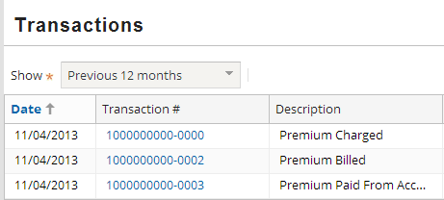
Transaction number generation in the base application: Examples
seed
adjunct
Transaction numbers are composed of "SEED-ADJUNCT"
  Transactions generated at the same time typically make use of the same seed value (such as the 11/04 transactions above)
Notes:
In the example above, one transaction was created on 09/15. This transaction used a seed of "1000000000". The next four transactions were generated a day later. At this point, a new seed value, "1000000001", had been retrieved. All four transactions on 09/16 use the same seed value.
Number Generator Integration - <number>

Slide 32

Transaction number generation in the base application: Code
In the base application, Transaction numbers are generated using a SeedWithNumericAdjuncts class
Syntax to create instances:
new SeedWithNumericAdjuncts(greatestAdjunctInt, blockThatIdentifiesHowToGenerateSeed)
  greatestAdjunctInt determines the length of the adjuncts and the maximum adjunct
  The block identifies how to generate the seed value whenever a new seed is needed
Notes:
The SeedWithNumericAdjuncts class is a special BillingCenter class whose purpose is to create multiple unique numbers from a single unique value. The constructor takes two values: greatestAdjunctInt and a block.
greatestAdjunctInt is an integer that determines the length and maximum value of the adjuncts to be used for a single seed. The minimum value is always 0. The maximum value is the value of greatestAdjunctInt. The length of the adjunct is always equal to the length of greatestAdjunctInt. For example:
If greatestAdjunctInt is 9, then there will be 10 adjuncts, from 0 to 9.
If greatestAdjunctInt is 99, then there will be 100 adjuncts, from 00 to 99.
If greatestAdjunctInt is 999, then there will be 1000 adjuncts, from 000 to 999.
The block identifies how to generate a new seed value. In the base application, the block simply calls the SequenceNumberGenerator's private generateSequenceID function.
A new seed is retrieved when the first number is generated for a given instance of SeedWithNumericAdjuncts. The first number generated will use an adjunct of 0 (or 00 or 000 as appropriate). Each time a number is generated within the same JVM node, the next higher adjunct is used unless that most recent adjunct used is equal to greatestAdjunctInt. When the last adjunct used is equal to greatestAdjunctInt, then a new seed is retrieved and an adjunct of 0 is used.
The SeedWithNumericAdjuncts class separates the seed and adjunct with a hyphen. You can modify the class to remove the hyphen or use another value in its place.
Keep in mind that even though adjuncts are guaranteed to be the same length, seed value are not inherently guaranteed to be the same length. Consequently, the generated numbers returned by SeedWithNumericAdjuncts are not guaranteed to be the same length. If generated numbers must always be of the same length, then you must write your seed generation logic to ensure that seed values are of the same length.
Number Generator Integration - <number>

Slide 33
Lesson objectives review
You should now be able to:
  Understand the role of number generation in each Guidewire application
  Implement the number generator plugins
Notes:
Number Generator Plugins- <number>

Slide 34
Review questions
Each number generator method has one input parameter. What is the parameter's value? When would you reference the parameter?
In ClaimCenter:
  When is a claim issued a temporary claim number?
  When is a claim issued a permanent number?
  Under what circumstances would you need to configure a field validator?
In PolicyCenter, what is the difference between a "policy number" and a "policy period number"?
In BillingCenter, why is having optimal code more important for the Transaction entity than for any of the other entities that make use of generated numbers?
Notes:
Number Generator Plugins- <number>
Answers
1. The input parameter is the entity instance that needs the number. You would reference the parameter if you needed to use information about the object when generating the number.
2. a) A claim is issued a temporary number at the start of the New Claim wizard as soon as the policy has been identified and the claim object created. Normally, the temporary number is not displayed in the UI, though it can be seen if one executes a search that includes in-progress claims.
b) A claim is issued a permanent number after successful completion of the New Claim wizard (or during import if it is coming from an external FNOL application).
c) You would need to configure a field validator if the values generated by the claim number generator plugin conflict with any existing field validator for the ClaimNumber field.
3. They are the same thing. The value commonly referred to as the "policy number" is the "PolicyNumber" field on PolicyPeriod. This value is typically not referred to as the "policy period number".
4. Transaction instances are created more often than any other instances in BillingCenter that make use of generated numbers. Therefore, the logic that generates transaction numbers must support high-volume throughput.

Slide 35
Soft copy of INumberGenerator
See the notes for a soft copy of the code
Notes:
package acme.bc.plugin.numgen
uses gw.plugin.numbergenerator.INumberGenerator
uses gw.api.util.StringUtil
uses gw.api.system.database.SequenceUtil
class AcmeINumberGenerator implements INumberGenerator {
override function generateAccountNumber(anAccount : Account) : String {
if (anAccount.AccountNumber != null) {
return anAccount.AccountNumber
} else {
var accountNameSuffix = StringUtil.formatNumber(
SequenceUtil.next(1, "acme-account"), "000000")
return "ACCT-" + accountNameSuffix
}
}
override function generateCollateralRequirementNumber(p0 :
CollateralRequirement) : String {
return null //## todo: Implement me
}
override function generateDisbursementNumber(p0 : Disbursement) : String {
return null //## todo: Implement me
}
override function generateInvoiceNumber(p0 : Invoice) : String {
return null //## todo: Implement me
}
override function generateStatementNumber(p0 : ProducerStatement) : String {
return null //## todo: Implement me
}
override function generateTransactionNumber(p0 : Transaction) : String {
return null //## todo: Implement me
}
override function generateTroubleTicketNumber(p0 : TroubleTicket) : String {
return null //## todo: Implement me
}
}
Number Generator Integration - <number>

Slide 36
Notices
Copyright © 2001-2013 Guidewire Software, Inc. All rights reserved.
Guidewire, Guidewire Software, Guidewire ClaimCenter, Guidewire PolicyCenter, Guidewire BillingCenter, Guidewire Reinsurance Management, Guidewire ContactManager, Guidewire Vendor Data Management, Guidewire Client Data Management, Guidewire Rating Management, Guidewire InsuranceSuite, Guidewire ContactCenter, Guidewire Studio, Guidewire Product Designer, Guidewire Live, Guidewire DataHub, Guidewire InfoCenter, Guidewire Standard Reporting, Guidewire ExampleCenter, Gosu, Deliver Insurance Your Way, and the Guidewire logo are trademarks, service marks, or registered trademarks of Guidewire Software, Inc. in the United States and/or other countries.
Guidewire products are protected by one or more United States patents.
Notes:
Notices - <number>

